Slide 1

Bitcoin: A Peer-to-Peer Electronic Cash System
Husam Al Jawaheri
201103311

Slide 2
Motivation
Physical cash
Non-traceable (well, mostly!)
Secure (mostly)
Impractical for the current needs (online transactions etc..)
Electronic credit or debit transactions
Bank sees all transactions
Merchants can track/profile customers
Based on trust

Slide 3
The Problem
Current system works almost well for most transactions, BUT!
Non-reversible transactions are not really possible (mediation of disputes)
Cost of mediation -> increases transaction costs -> small transactions not practical..
Possibility of reversal = more need for trust
What happens then?
Merchants must be wary of their customers
Ask for more information -> less anonymity
All of this can be avoided if physical currency is used! However..
No mechanism for payments online without a trusted party ☹

Slide 4
What do we need?
An electronic payment system that is:
Based on cryptographic proof instead of trust
Allows for transactions without a trusted third party
Transactions are impractical to reverse
The solution? BITCOIN!
A distributed, decentralized digital currency system

Slide 5
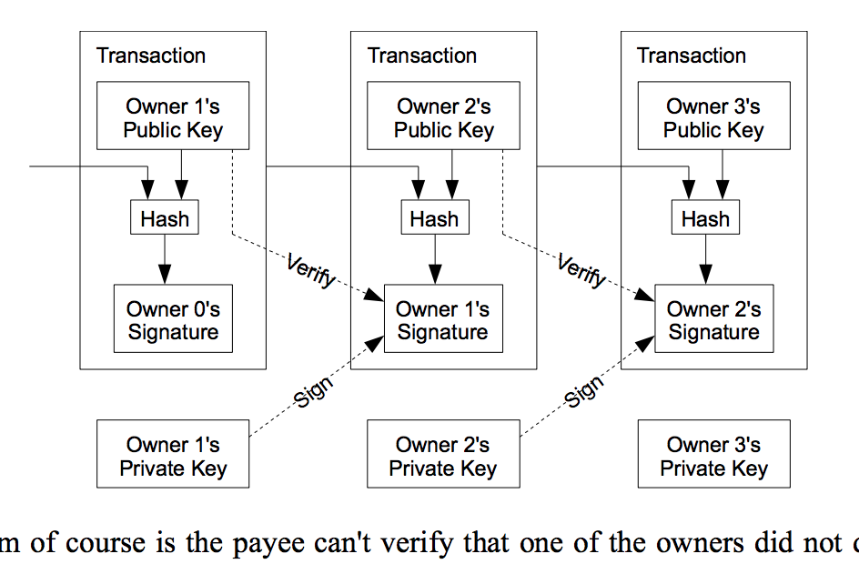
How it works?
What is a bitcoin?
We define an electronic coin as a chain of digital signatures
How coins are transferred?
By digitally signing a hash of the previous transaction
and the public key of the next owner
A payee can verify the signatures to verify
the chain of ownership
What is the problem?
Payee can't verify that a coin was not double-spent

Slide 6
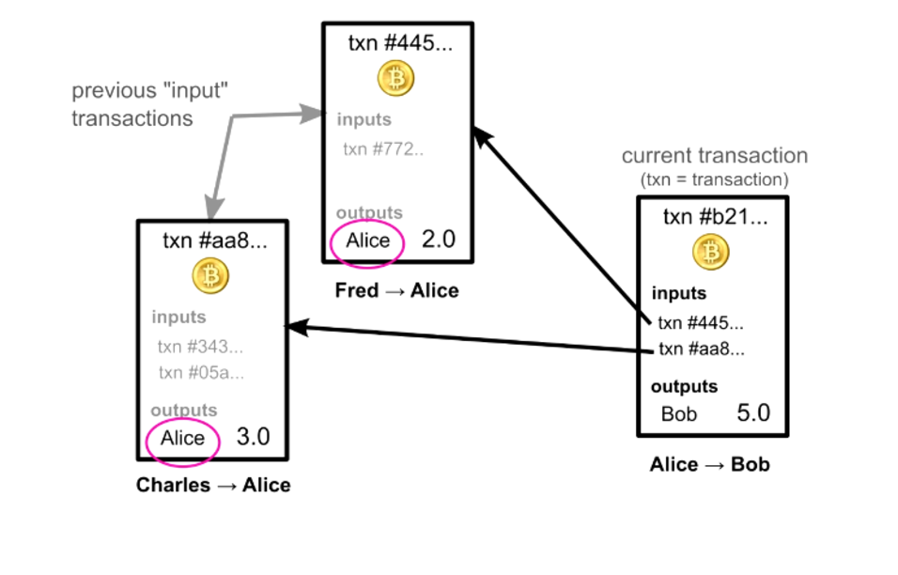
Transaction example

Slide 7
Timestamp Server
To confirm the presence/absence of a transaction you have to be aware of all transactions
Normally banks/central authority are aware of this
To accomplish this without a trusted party?
Transactions must be publicly announced
We need a system for participants to agree on the order in which transactions were received -> Timestamp server

Slide 8
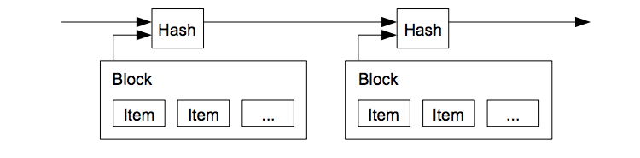
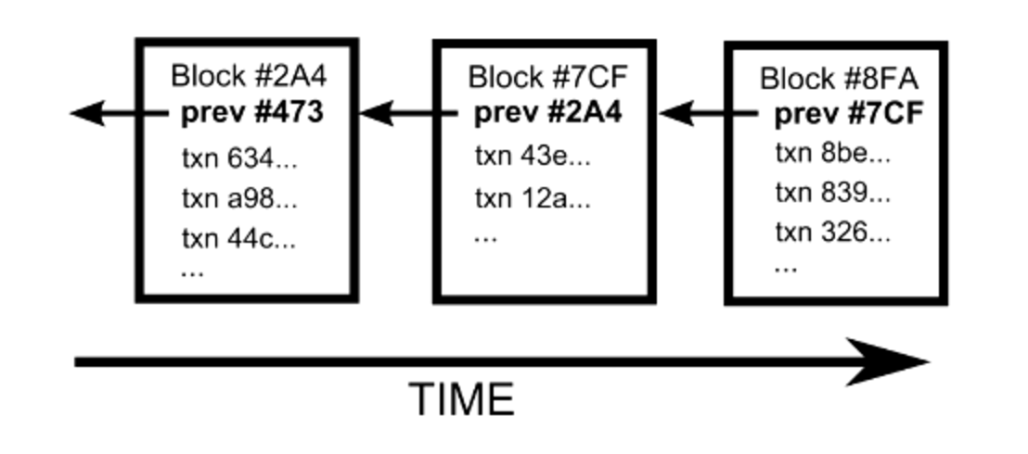
Timestamp Server
A timestamp server works by:
taking a hash of a block of items to be timestamped
widely publishing the hash (just like in a newspaper)
It proves that the data must have existed at the time
Each timestamp includes the previous timestamp in its hash forming a chain -> Thus the name the Blockchain

Slide 9
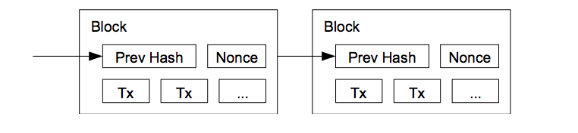
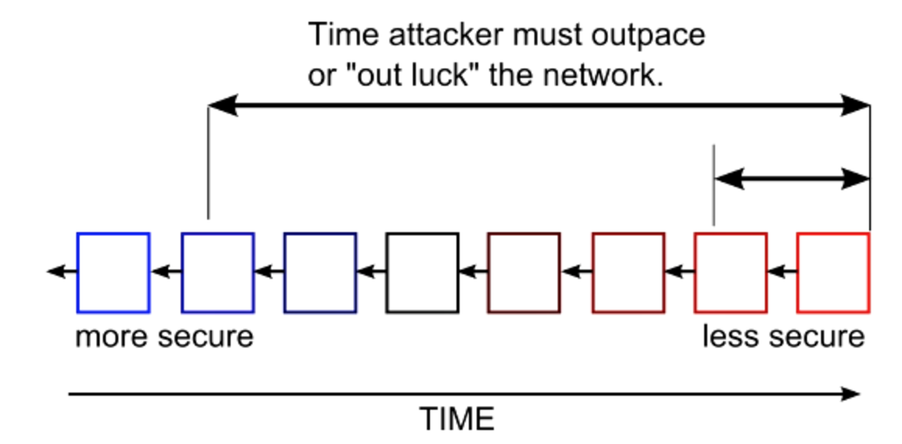
Proof-of-work
To make timestamp server work on a P2P -> proof of work is needed!
Lets think of it as a mathematical puzzle..
Just a nounce added at the end of the block
If its solved the block is added to the blockchain
Majority decision = longest chain
An attacker would need to redo the whole proof-of-work
The more blocks added = the harder to redo the work

Slide 10
Clearer Picture of the Network
Steps for running the P2P network:
1- New transactions are broadcast to all nodes.
2- Each node collects new transactions into a block.
3- Each node works on finding a difficult proof-of-work for its block.
4- When a node finds a proof-of-work, it broadcasts the block to all nodes.
5- Nodes accept the block only if all transactions in it are valid and not already spent.
6- Nodes express their acceptance of the block by working on creating the next block in the chain, using the hash of the accepted block as the previous hash.

Slide 11
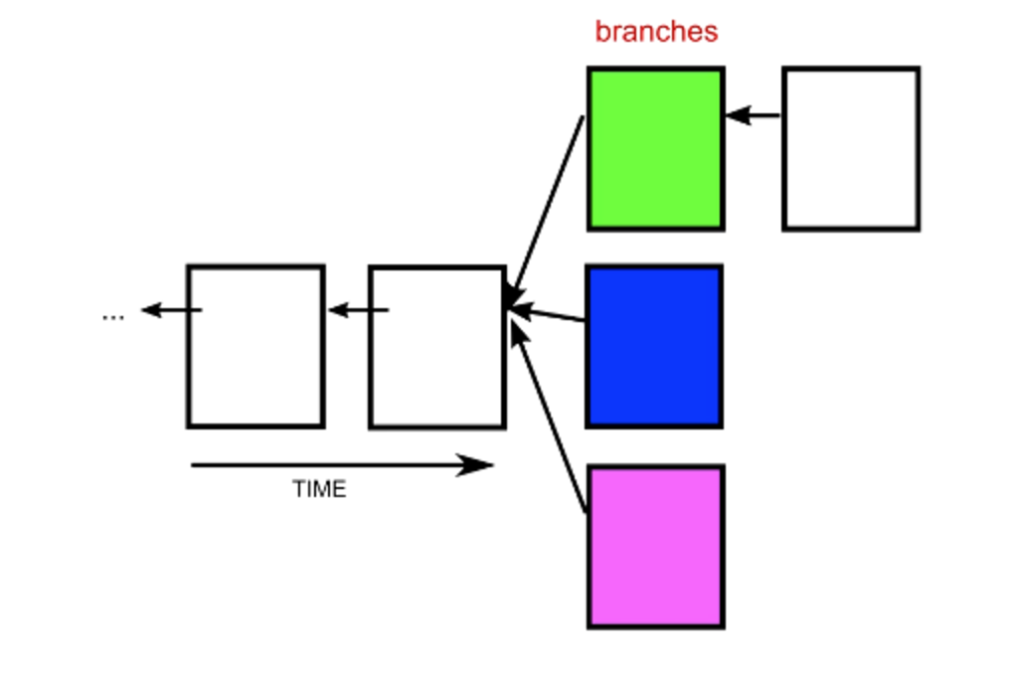
What if two blocks at same time?
Very small probability that this happens
If it happens?
We will have branches..
What to do?
Build on top of the first one you received
The tie gets broken when someone
solves another block
Then you immediately switch to the longest branch
The Blockchain quickly stabilizes (hard math +
low chances of this happening)

Slide 12
Incentive
First transaction in a block = a coin owned by the creator
Why is this?
Incentive for nodes to support the network
Since they are donating CPU power and electricity
The incentive help to encourage nodes to stay honest
An attacker can only change the chain order if he has 50%+ of CPU power
Defraud people vs generating new coins? Better play by the rules..
A new concept of Bitcoin mining appears

Slide 13
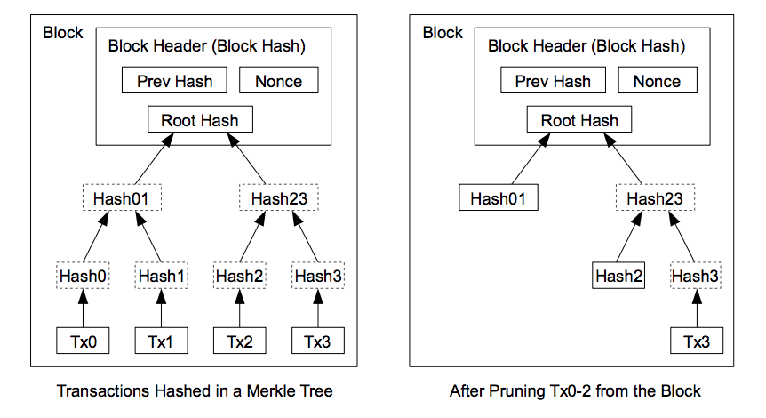
How to save disk space?
If we have latest transaction older spent transactions are not needed
But if we remove old ones the block hash will break .. So?
Hash transactions in a Merkle Tree
Will not go into details..
What is important? Only have the root hash
and prune the remaining tree
Block header = 80 bytes
If we have 1 block/10 minutes
Then 80 bytes * 6 * 24 * 365 = 4.2MB per year
With Moore’s law this is no problem ..

Slide 14
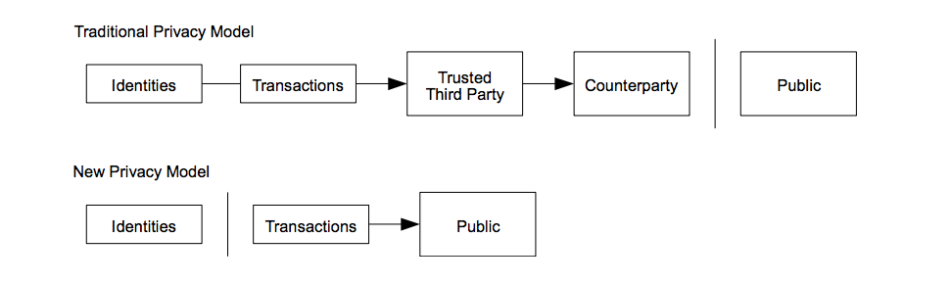
Privacy
In traditional banking
Privacy is achieved by limiting the access to information
In Bitcoin transactions are public.. how privacy is achieved?
By keeping public keys anonymous (You only know the hash of the key)
You can see that there is a transaction .. But from who to who? Good luck!
Some linking might be possible if one address is de-anonymized!
A good idea is to generate a new key pair for each transaction
Be aware of distributing your public keys!

Slide 15
Conclusion
Bitcoin is a crypto-currency that does not rely on trust
Transactions are composed of
Inputs: references to previous transactions owned by the same user
Outputs: public keys of user receiving the coins
Transactions are stored in a P2P public ledger called Blockchain
The network is kept alive by the collaboration of honest nodes
Bitcoin provides a great way to exchange money anonymously

